Slide 1
Introduction to shiny
Amit Arora

Slide 2
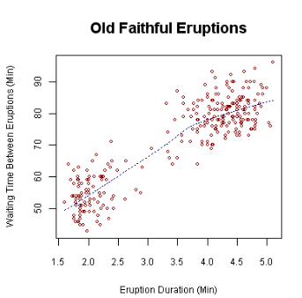
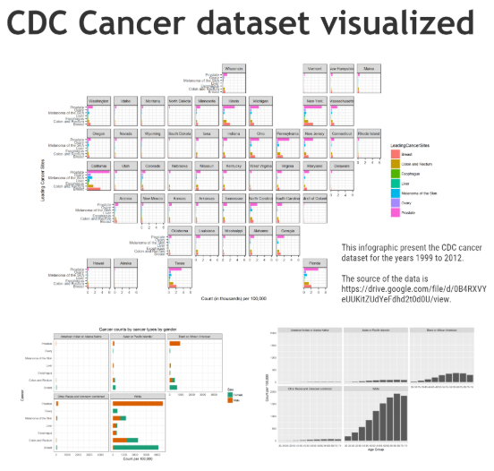
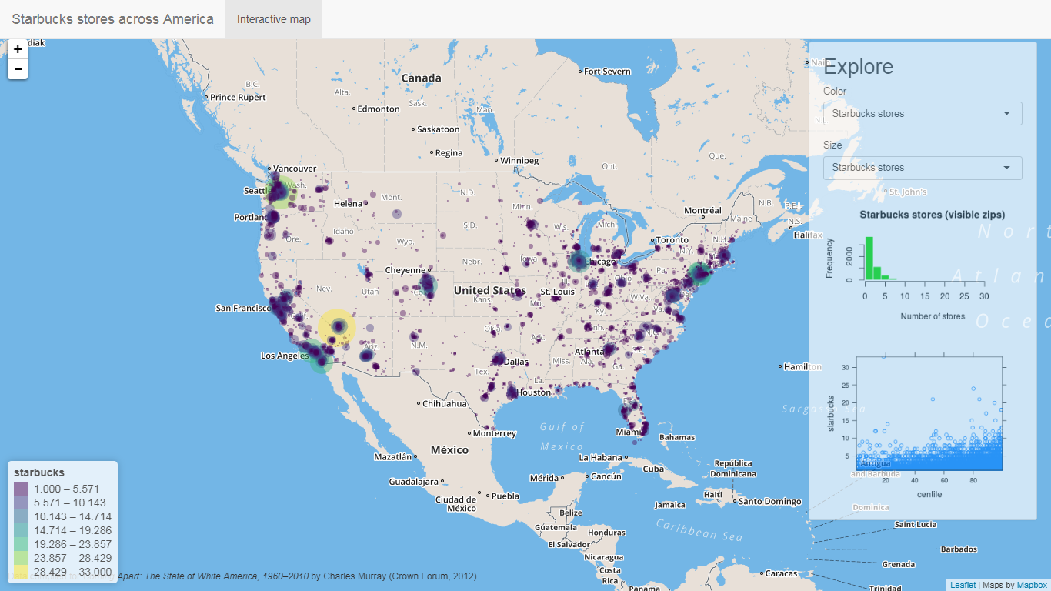
Why do we need shiny (or something like that)
Simple Plot
Infographic
Interactive Dashboard (link)
Not only do we want interactivity, we want coordinated interactivity!!!

Slide 3
But we do have interactive plots…
Is it possible to make something that allows as much use interaction but does not require shiny?
For example what if a charting library which is anyway Javascript based (all of them are) can use some more Javascript to provide common UI features like buttons and sliders.
Answer is, it depends. For simple applications it is possible and it is probably the right choice there, but for anything as feature rich as typically shiny apps are, this wont work.
Plotly provides custom controls https://plot.ly/r/#controls, along with htmlwidgets (link) and crosstalk (link) we could make simple apps. Advantage is that these are completely client side which makes them faster. The output is an html file so you could email it, host it on a web server, but it does not require an R environment to live.
Shiny on the other hand addresses coordination between individual plots by allowing the programmer to define those interactions in R code.
What happens if the application needs to actually to download data from a data source (web server, database), what happens if the data needs to be periodically refreshed? We do need Shiny there.

Slide 4
Moving towards shiny…
Lets just say Shiny is an R package that allows us to build dashboards from super simple to super advanced with complex user interactions without having to know any javascript, css or html*
Follows a client (UI) server model where UI defines the user interface elements and server defines the backend server code except that both UI and Server code is just regular R code.

Slide 5
Shiny dashboards
HTML
Awareness
required
HTML5
Bootstrap
Shiny dashboard
Shiny runtime
Flex Dashboard
Very little HTML awareness required (Uses R Markdown)

Slide 6
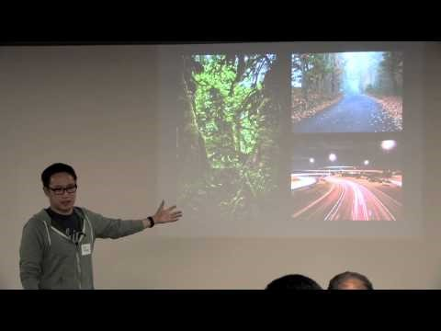
Reference Material
Introductory Video | Introduction to Shiny from the person who designed it
Reference book | https://mastering-shiny.org/
Crosstalk | https://www.rstudio.com/resources/videos/linking-html-widgets-with-crosstalk/
Flexdashboard | https://rmarkdown.rstudio.com/flexdashboard/

Slide 7
Live code
We will do a simple Shiny code demo first and then a Flexdashboard demo.
Combine flexdashboard and Shiny.

Slide 8
Ideas we will need for making anything of practical use…
Some packages that we almost always would use in a Shiny dashboard
Package | Purpose | Functions
ggplot2 | General purpose charting library (non-interactive) | plotOutput, renderPlot
Plotly | General purpose charting library | plotlyOutput, renderPlotly
Highcharts | General purpose charting library | highchartOutput, renderHighchart https://github.com/rstudio/shiny-examples/tree/master/118-highcharter-births
Data Table (DT), Also look at “gt” | Display nicely formatted, searchable, interactive tables | renderDT, DTOutput https://shiny.rstudio.com/gallery/basic-datatable.html
Dygraphs | Timeseries | renderDygraph, dygraphOutput https://rstudio.github.io/dygraphs/shiny.html

Slide 9
A list of recipes I use all the time
Task | Why is it typically needed? | Functions
How to upload a file in your Shiny app | Allow user to input data in bulk and then provide it to a model or render it on the UI | https://shiny.rstudio.com/articles/upload.html
How to download a file | Once the model runs and provides data or other backend processing is done or the user simply wants to download data being shown on the UI. | https://shiny.rstudio.com/articles/download.html
How to get a progress bar(s) in your Shiny app | When the app is processing data or waiting for output from the model, need a progress bar to indicate something is happening. | https://shiny.rstudio.com/articles/progress.html https://shiny.rstudio.com/gallery/progress-bar-example.html
Maps in a Shiny App | Use maps all the time for everything | Leaflet for R https://rstudio.github.io/leaflet/shiny.html

Slide 10
Ideas we will need for making anything of practical use…
Reactive expressions, Observable events
(see this link https://shiny.rstudio.com/tutorial/written-tutorial/lesson6/)
OutputProxy
(see https://www.rdocumentation.org/packages/leaflet/versions/2.0.2/topics/leafletProxy and https://plot.ly/r/plotlyproxy/ for examples)

Slide 11
Additional Resources
Title | Link | Notes
Shiny in production (golem package) | https://engineering-shiny.org https://www.barcelonar.org/presentations/BarcelonaR_Building_Production_Grade_Shiny_Apps_with_golem.pdf https://www.youtube.com/watch?v=YljErMnQqm0&feature=youtu.be (EARL 2020 conference) | Online book. Not an entry level book but must read if you intend to build enterprise grade Shiny apps.
Awesome Shiny Extensions | https://github.com/nanxstats/awesome-shiny-extensions | How to build, deploy, test, UI, backend etc.). Not updated for 2 years though.
Shiny Gallery | https://shiny.rstudio.com/gallery/ https://blog.rstudio.com/2020/07/13/winners-of-the-2nd-shiny-contest/ | If you are looking for examples of what is possible with Shiny, look no further!
Shiny app on Google Cloud Run | https://code.markedmondson.me/shiny-cloudrun/ | Cloud hosted Shiny App without Rstudio Connect

